Slide 1

Smart Dustbin using & Arduino Uno Ultrasonic Sensor

Slide 2
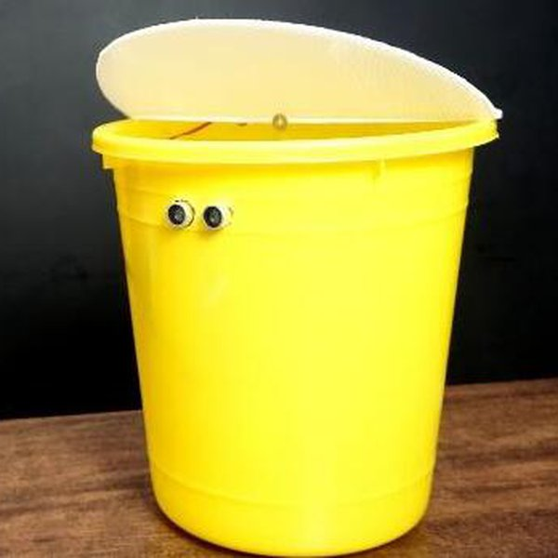
Introduction
With increase in population we have an increase in the garbage around urban areas. Here we propose a smart dustbin that operates automatically to help solve this issue using IOT and sensor based circuitry. Smart bin is built on a microcontroller based platform Arduino Uno board which is interfaced with GSM modem and Ultrasonic sensor. Ultrasonic sensor is placed at the top of the dustbin which will measure the stature of the dustbin. The threshold stature is set as 10cm.

Slide 3

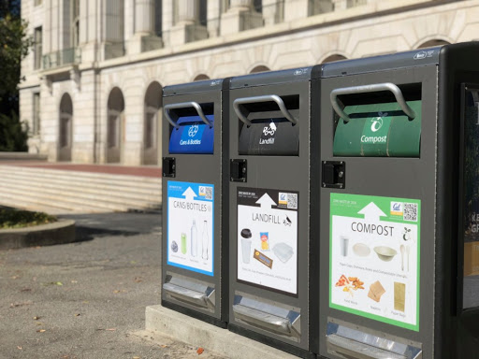
Problem Description
To implement a smart bin built on a microcontroller based platform Arduino Uno board which is interfaced with GSM modem and Ultrasonic sensor which can gives the status of the waste present in the dustbin to the municipal authority
With the use of these smart dustbins we can keep our streets much more cleaner than before eventually which will help in keeping the whole society clean and so on.

Slide 4

Components Used
Arduino
GSM
PIR Sensor
Ultrasonic Sensor
Servo Motor
Breadboard
Connecting wires

Slide 5
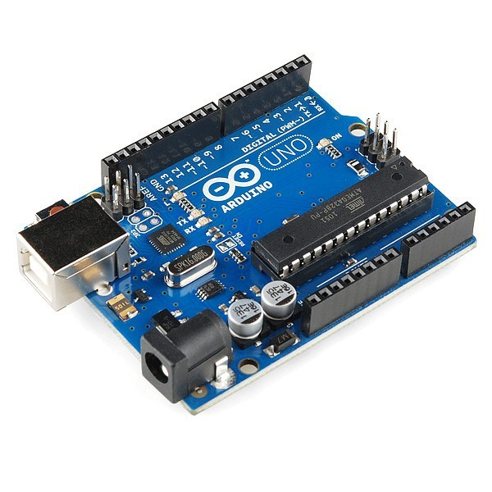
Arduino: Arduino is an open source, computer hardware and software company, project, and user community that designs and manufactures microcontroller kits for building digital devices and interactive objects that can sense and control objects in the physical world.
GSM: GSM Modem can accept any GSM network operator SIM card and act just like a mobile phone with its own unique phone number. Advantage of using this modem will be that you can use its RS232 port to communicate and develop embedded applications.
PIR Sensor: PIR sensors allow you to sense motion. They are used to detect whether a human has moved in or out of the sensor’s range. They are commonly found in appliances and gadgets used at home or for businesses.
Ultrasonic Sensor: The HC-SR04 ultrasonic sensor uses SONAR to determine the distance of an object just like the bats do. It offers excellent non-contact range detection with high accuracy and stable readings in an easy-to-use package from 2 cm to 400 cm or 1” to 13 feet. The operation is not affected by sunlight or black material, although acoustically, soft materials like cloth can be difficult to detect.

Slide 6
Servo Motor: A Servo Motor is a small device that has an output shaft. This shaft can be positioned to specific angular positions by sending the servo a coded signal. As long as the coded signal exists on the input line, the servo will maintain the angular position of the shaft. If the coded signal changes, the angular position of the shaft changes.
Breadboard: A breadboard is a construction base for prototyping of electronics. Originally it was literally a bread board, a polished piece of wood used for slicing bread. Because the solderless breadboard does not require soldering, it is reusable. This makes it easy to use for creating temporary prototypes and experimenting with circuit design.

Slide 7
Flow Chart of Working Principle
Dustbin placed in public place, people throw garbage in dustbin, place the ultrasonic sensor in top of the garbage bin. If dustbin reach in 75% then Arduino send message through GSM module. When dustbin level is reach threshold level buzzer will give alert sound for don’t again put waste in dustbin. This all process updated in IOT GECKO platform for monitoring garbage bin.

Slide 8
Transmitter Part of Dustbin
Level detector consists of IR sensors which is used to detect the level of the garbage in the dustbin. The output of level detector is given to microcontroller. Four IR sensors are used to indicate the different levels of the amount of the garbage collected in the dustbin which is placed in public area. When the dustbin is filled up to the highest level, the output of fourth IR receiver becomes active low. This output is given to microcontroller to send the message to the Control room.

Slide 9
Reception Part to Dustbin
At receiver, control room is present where all the activities are managing. The number of the control room is depending on the dustbins present in the area. The person sitting in the control room monitors the entire system. A GSM Module is connected to the computer of the control room through microcontroller. The entire system is monitor by the person sitting in the control room. The same GSM Module is used to send the message to the contractor for cleaning the dustbin.

Slide 10
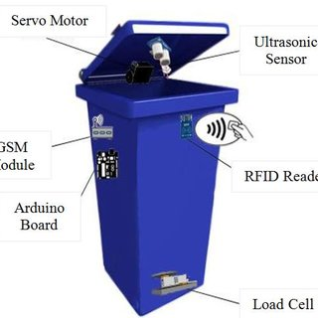
Test Results
The dustbin is able to open the lid with the help of servo motor and PIR sensor whenever it detects motion. The ultrasonic sensor is giving the details about the waste present in the dustbin. The status of the waste is transferred to the municipal authority whenever it is exceeding the threshold value.

Slide 11
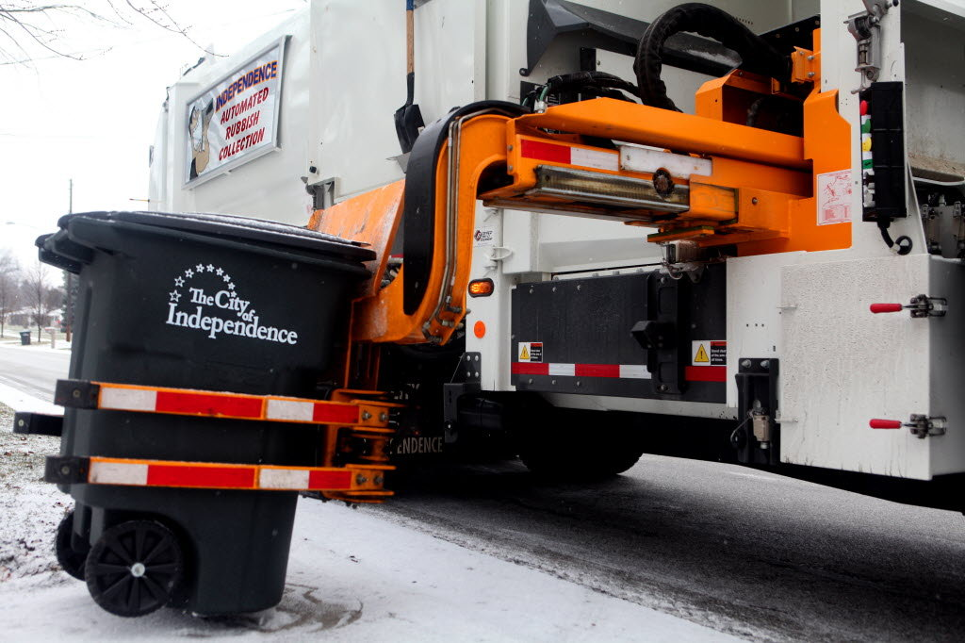
Future Enhancements
Automatic Garbage Fill Alerting system helps us to reduce the pollution. Many times garbage dustbin is overflow and many animals like dog or cow enters inside or near the dustbin. Also some birds are also trying to take out garbage from dustbin. This project can avoid such situations. And the message can be sent directly to the cleaning vehicle instead of the contractor’s office.

Slide 12
Thank You
Presented By: 19MCA0019 – Deepali Poddar
19MCA0014 – Stuti Mohan Srivastava
19MCA0011 – Vasudev Gupta

